Slide 1
Crop Production Analysis

Slide 2
Introduction
Overview of the importance of crop production in India
Brief on the significance of data analysis for informed decision-making
Emphasis on the role of agriculture in sustaining livelihoods and ensuring food security for India's growing population

Slide 3
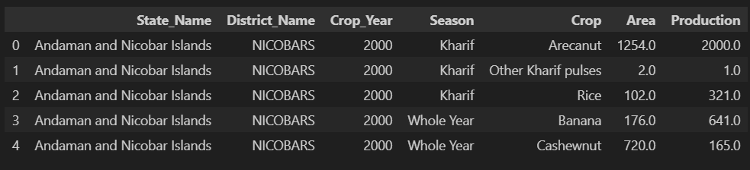
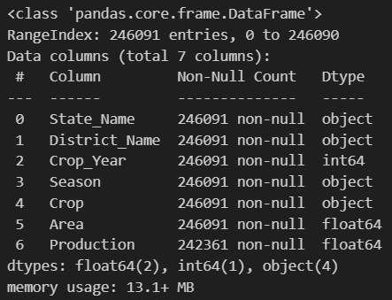
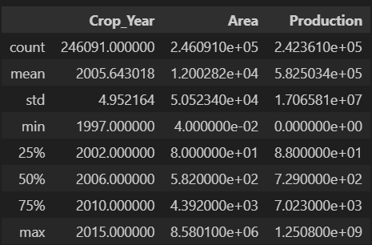
Details of Data

Slide 4
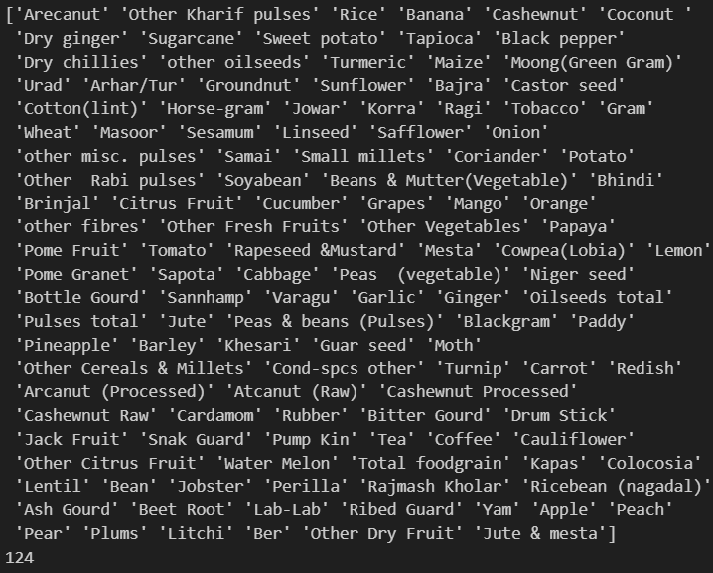
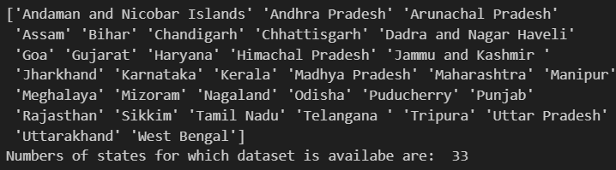
My Analysis
The total years taken into account:
The states and crops taken into consideration:

Slide 5
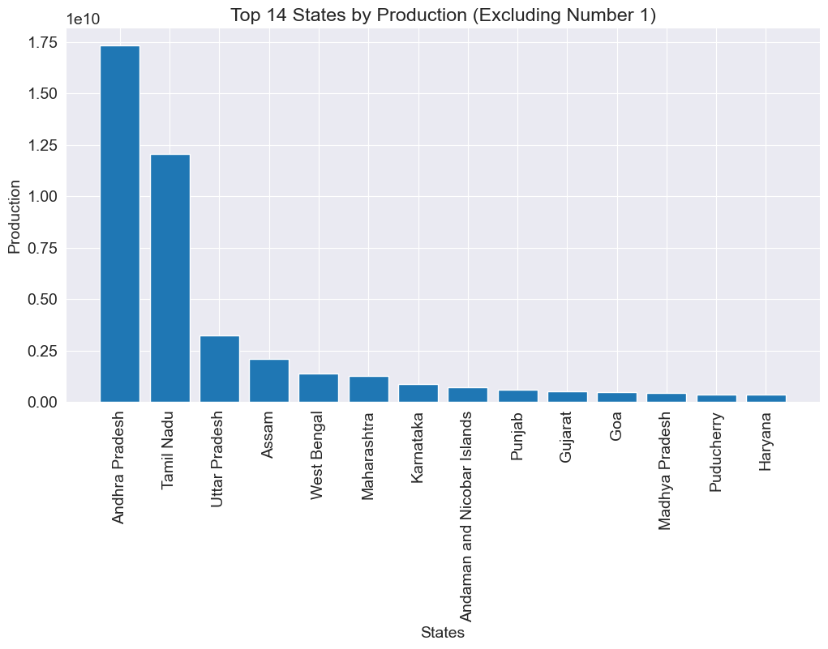
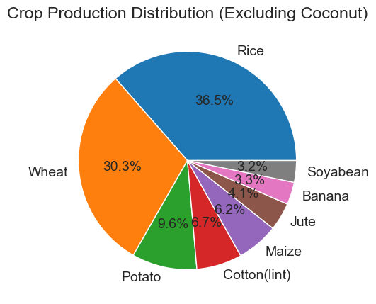
My Analysis

Slide 6
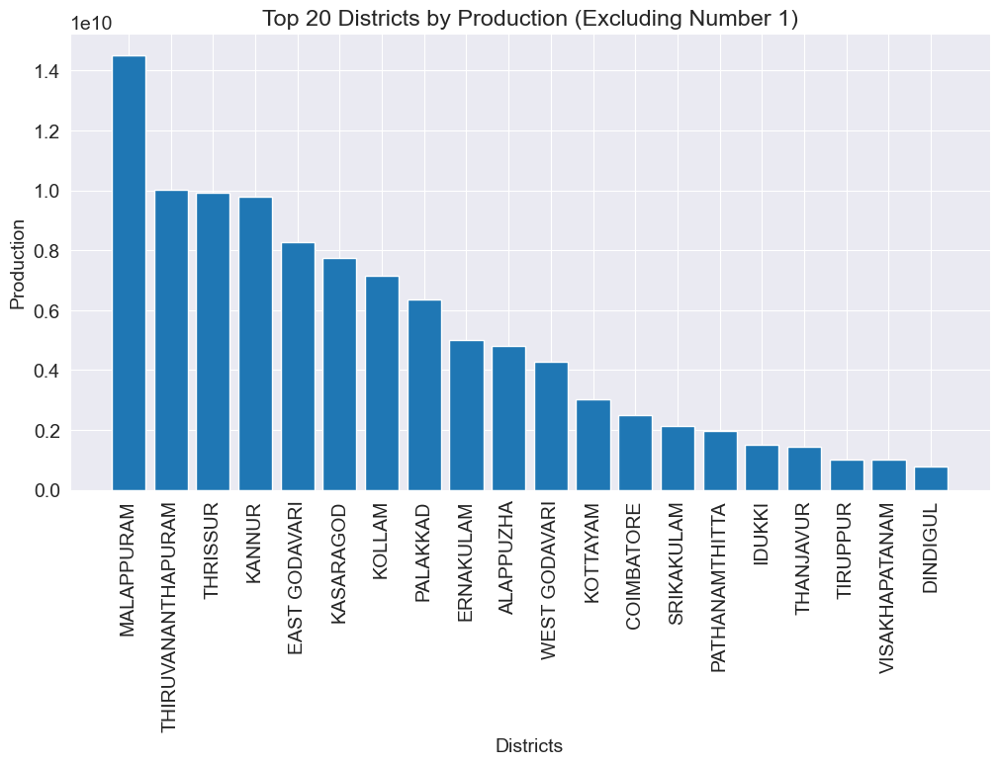
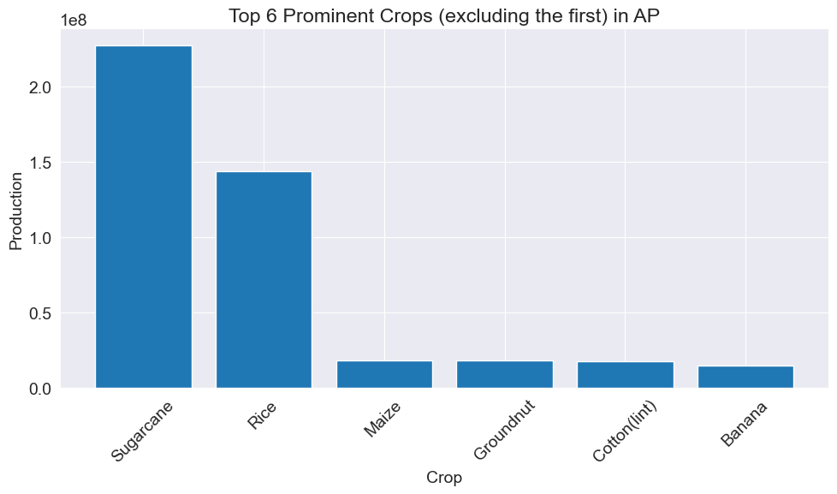
My Analysis

Slide 7
Thank you

